Slide 1


Topic: Robust parameter estimation and outlier detection in online streaming data using two-fold incremental Gaussian mixture model
PROJECT-II (MA47202) Presentation
submitted to Indian Institute of Technology, Kharagpur
in partial fulfillment for the award of the degree of Integrated Masters of Science in Mathematics and Computing by
Prabhav Sunil Patil
Roll Number: 20MA20042
Under the supervision of
Professor Swanand Khare

Slide 2
Thesis problem

Slide 3
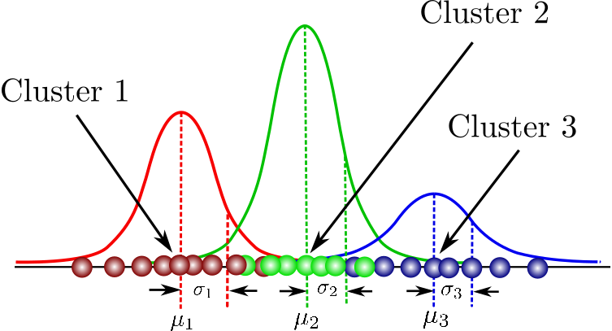
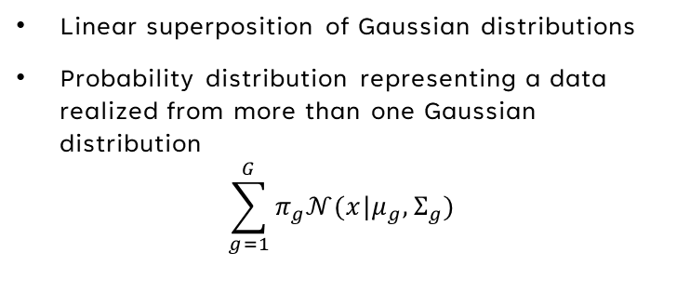
What is a gaussian mixture model?
Gaussian mixtures
Linear superposition of Gaussian distributions
Probability distribution representing a data realized from more than one Gaussian distribution
$$\sum_{g=1}^{G}{π_{g}𝒩(x|μ_{g},Σ_{g}) }$$
Gaussian mixture model
Statistical model used for density estimation and data clustering
Assumes the data is generated by gaussian mixtures
Each data point is assumed to belong to one of the Gaussian component with a certain probability
Techniques to estimate gaussian mixture model
EM Algorithm

Slide 4
Problem statement
Number of components stay fixed in the EM Algorithm
EM Algorithm requires static data
All of the data needs to be present to compute the exact estimate of parameters
What about dynamic data?
Approach: Estimate the parameters again and again every time a new data point approaches
Suffers from high computational complexity. Increases as the data set increased
Will not work when data set becomes very large
Online training
Finding a model which is designed to learn the GMMs from the data flow in an incremental manner
Finding an approach which updates the current estimates as and when another data point is added to the model
Furthermore, the approach should adaptively estimate the number of components, i.e., a completely unsupervised model

Slide 5
Our Contribution

Slide 6
Our contribution
We develop a two-fold incremental Gaussian mixture framework to estimate parameters from an online data stream
Efficient representation of parameters of origin of data stream in the form of gaussian mixtures
Adaptive list of outlier estimated throughout the stream
Probabilistic framework
Complete Probabilistic framework where
Base estimation of parameters done through the assumption of a Gaussian Mixture model
Outliers are originally detected through the assumption of Gaussian mixtures
Density based Framework
Partially Probabilistic framework where
Base estimation of parameters done through the assumption of a Gaussian Mixture model
Established an incremental density-based clustering method to detect outliers instead of an assumption of their probability model

Slide 7
Related work

Slide 8
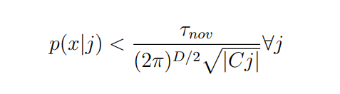
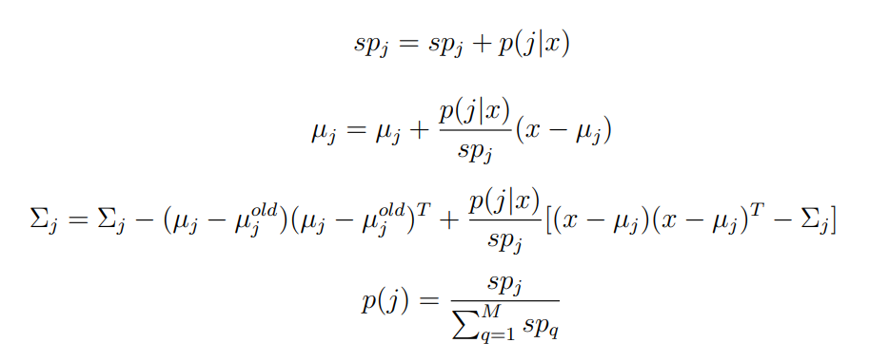
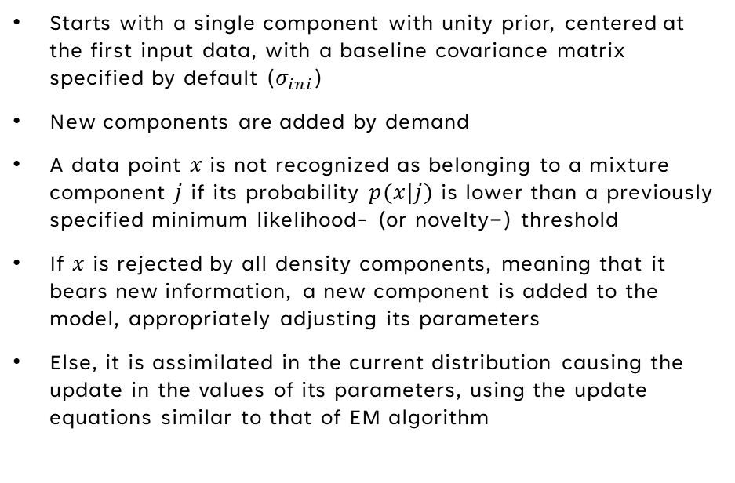
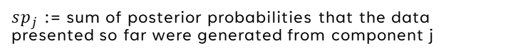
Incremental gaussian mixture model (IGMM)
EM Algorithm requires static data
All of the data needs to be present to compute the exact estimate of parameters
Creation of a new cluster
Description of the procedure
Starts with a single component with unity prior, centered at the first input data, with a baseline covariance matrix specified by default ($σ_{ini}$)
New components are added by demand
A data point $x$is not recognized as belonging to a mixture component $j$ if its probability $p(x|j)$ is lower than a previously specified minimum likelihood- (or novelty−) threshold
If $x$ is rejected by all density components, meaning that it bears new information, a new component is added to the model, appropriately adjusting its parameters
Else, it is assimilated in the current distribution causing the update in the values of its parameters, using the update equations similar to that of EM algorithm
Update equations
$sp_{j}$ := sum of posterior probabilities that the data presented so far were generated from component j

Slide 9
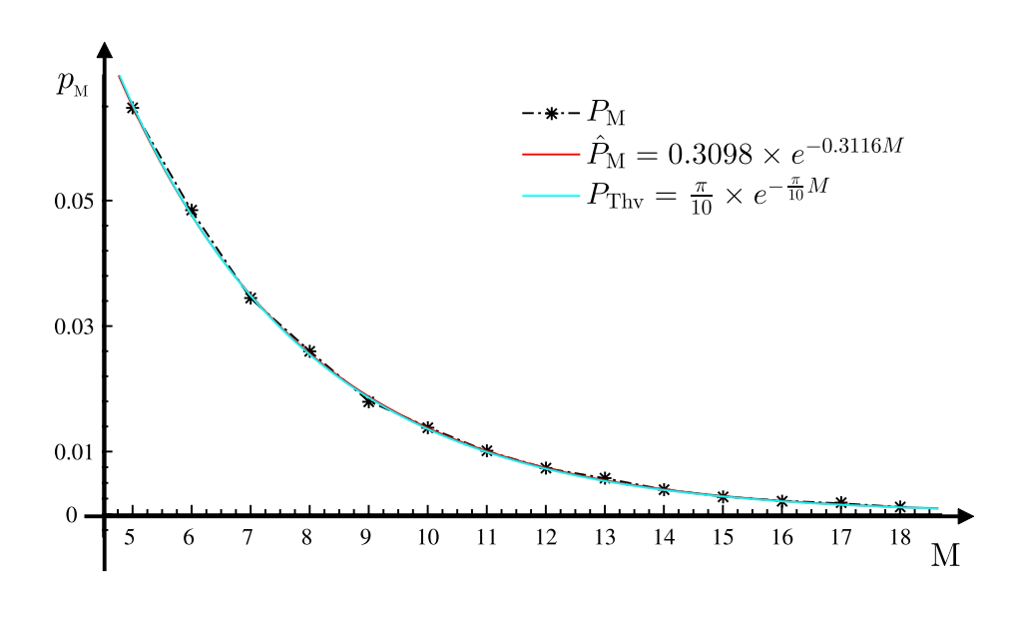
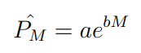
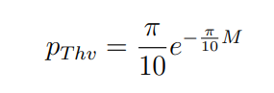
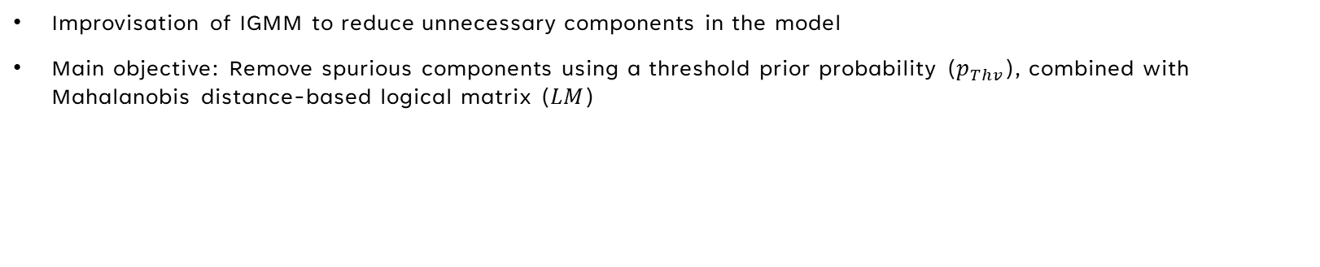
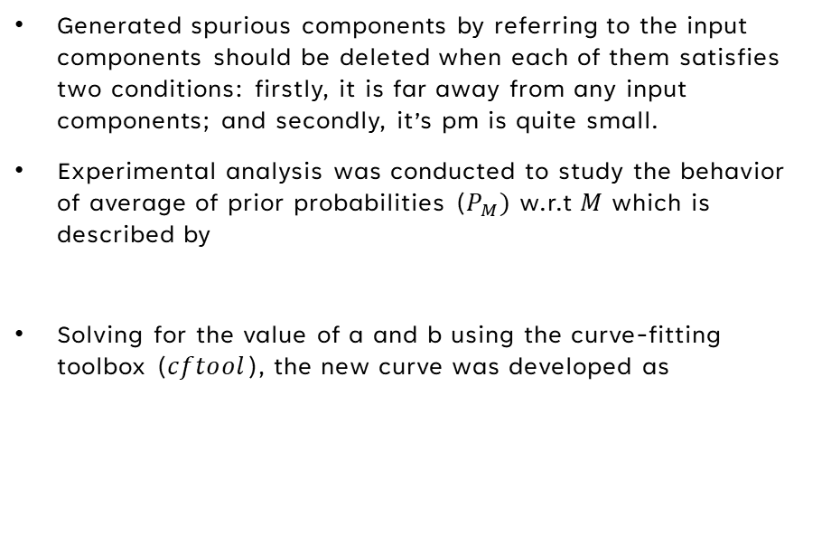
Modified Incremental gaussian mixture model (MIGMM)
Improvisation of IGMM to reduce unnecessary components in the model
Main objective: Remove spurious components using a threshold prior probability ($p_{Thv}$), combined with Mahalanobis distance-based logical matrix ($LM$)
Step 1: Removing spurious components on the basis of $p_{Thv}$ and its formulation
Generated spurious components by referring to the input components should be deleted when each of them satisfies two conditions: firstly, it is far away from any input components; and secondly, it’s pm is quite small.
Experimental analysis was conducted to study the behavior of average of prior probabilities ($P_{M})$ w.r.t $M$ which is described by
Solving for the value of a and b using the curve-fitting toolbox ($cftool$), the new curve was developed as
Relationship between $P_{M}$ and $M$

Slide 10
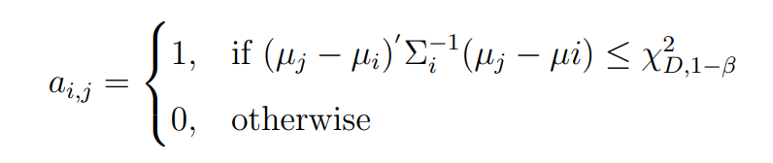
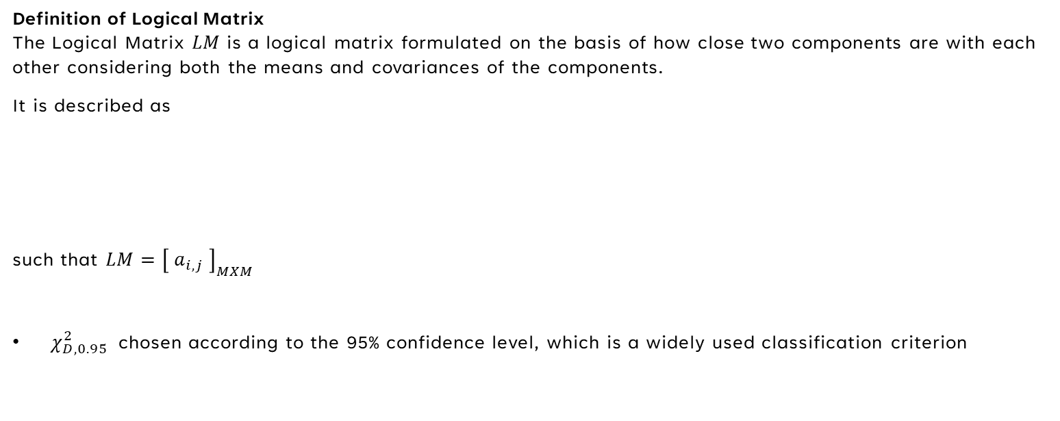
Modified Incremental gaussian mixture model (MIGMM)
Step 2: Removing spurious components on the basis of Logical matrix $LM$ and its formulation
Definition of Logical Matrix The Logical Matrix $LM$ is a logical matrix formulated on the basis of how close two components are with each other considering both the means and covariances of the components.
It is described as
such that $LM={\left[ a_{i,j} \right]}_{MXM}$
$χ_{D,0.95}^{2}$chosen according to the 95% confidence level, which is a widely used classification criterion

Slide 11
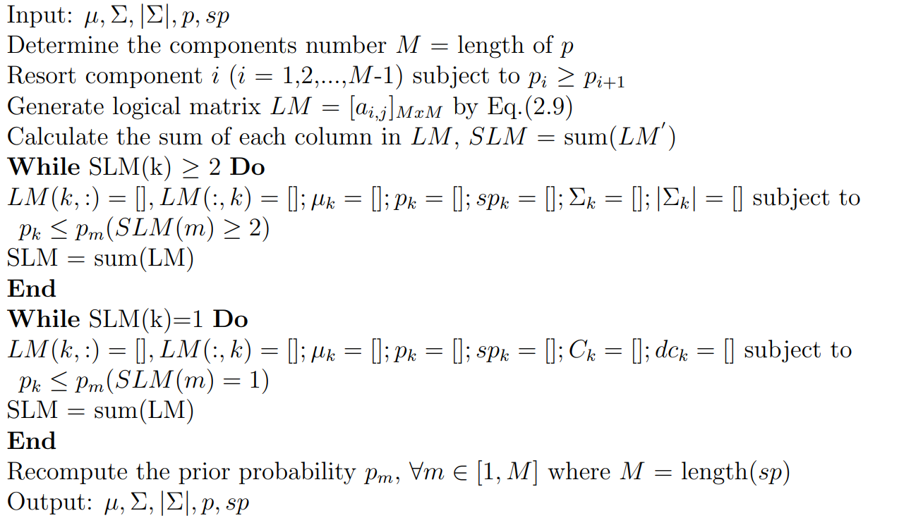
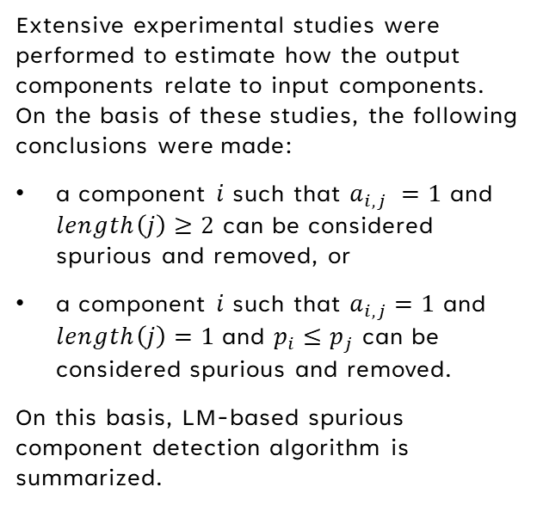
Modified Incremental gaussian mixture model (MIGMM)
Step 2: Removing spurious components on the basis of Logical matrix $LM$ and its formulation
Extensive experimental studies were performed to estimate how the output components relate to input components. On the basis of these studies, the following conclusions were made:
a component $i$ such that $a_{i,j} =1$ and $length\left(j\right)≥2$ can be considered spurious and removed, or
a component $i$ such that $a_{i,j}=1$ and $length\left(j\right)=1$and $p_{i}≤p_{j}$ can be considered spurious and removed.
On this basis, LM-based spurious component detection algorithm is summarized.

Slide 12
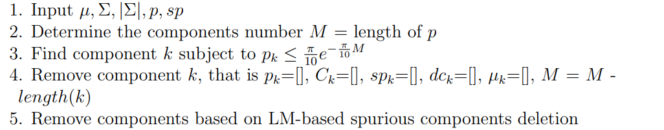
Fundamental limitation of migmm
The removal procedure of the MIGMM algorithm is described as follows.
This represents a two-phase model. First phase estimates the parameters on the basis of incremental data. Second phase removes the spurious components present in the estimate
This implies a spurious-removal procedure is performed once the data streaming is fully completed
Hence, at insertion of every new data point, the spurious-removal procedure needs to be performed to determine the correct parameters
Furthermore, the correct determination of the parameters at a previous step is not used for further steps
There is a need to find an approach which estimates the parameters as well as removes the spurious components in a parallel manner

Slide 13
Formulation of a new model

Slide 14
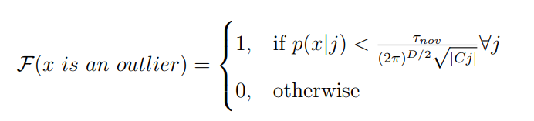
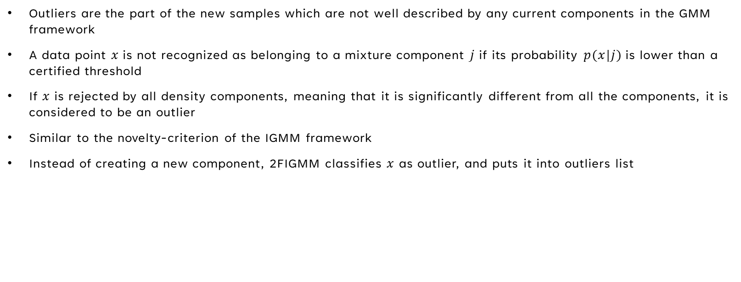
Two-fold Incremental gaussian mixture framework
Proposes a novel approach to identify the outliers as well as merge the outliers once they start to form a cluster
Proposed the design of an algorithm to inculcate the above methodology with IGMM along with an auxiliary model
Determination of an outlier
Outliers are the part of the new samples which are not well described by any current components in the GMM framework
A data point $x$is not recognized as belonging to a mixture component $j$ if its probability $p(x|j)$ is lower than a certified threshold
If $x$ is rejected by all density components, meaning that it is significantly different from all the components, it is considered to be an outlier
Similar to the novelty-criterion of the IGMM framework
Instead of creating a new component, 2FIGMM classifies $x$ as outlier, and puts it into outliers list

Slide 15
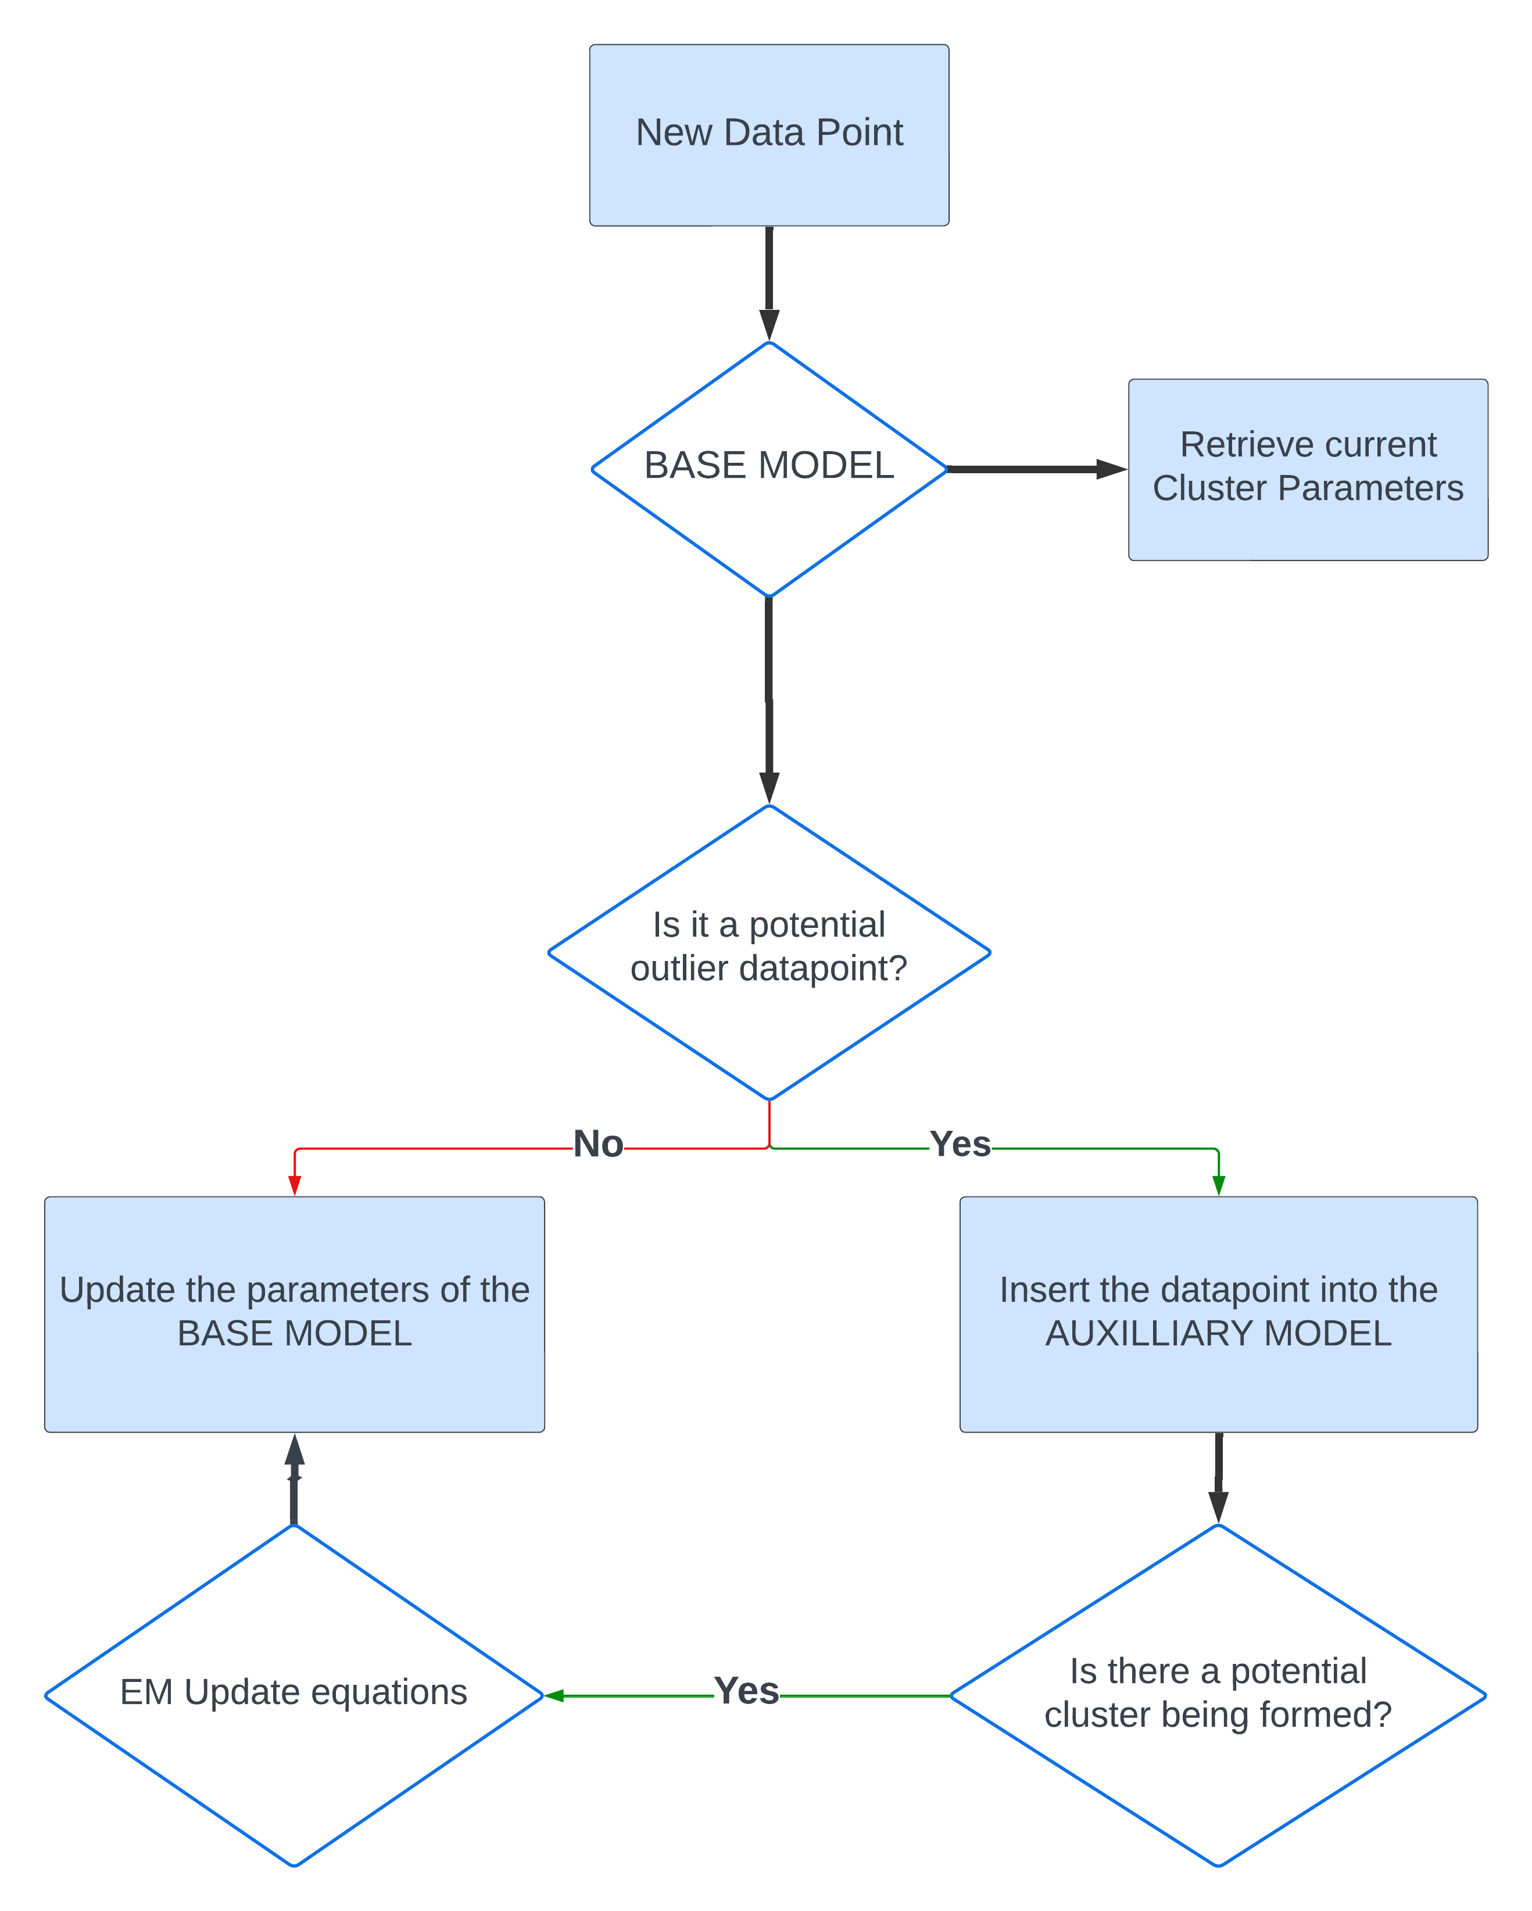
General outline of the framework
Two essential models working parallelly to retrieve the parameters of the data stream
Base Model
Auxiliary Model

Slide 16
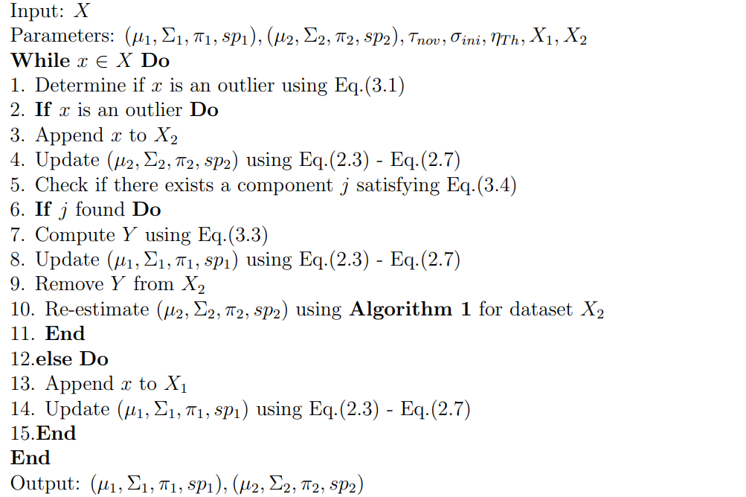
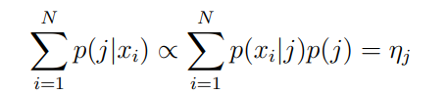
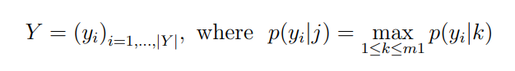
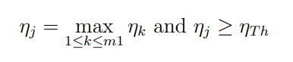
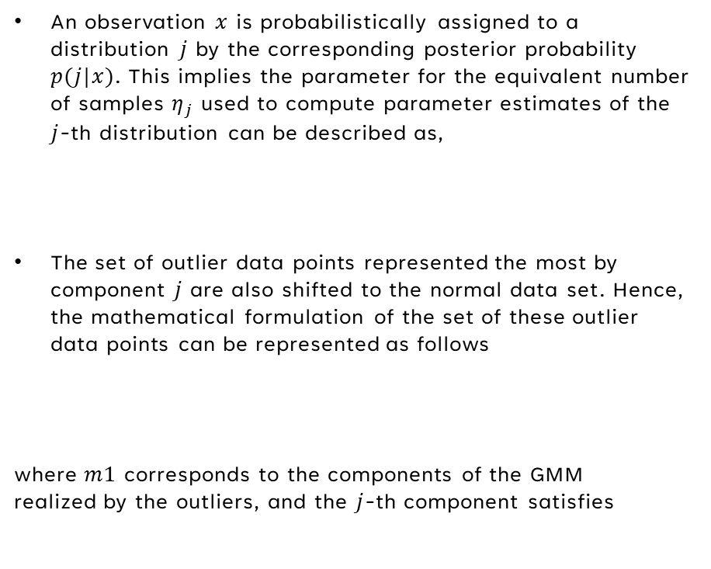
IGMM AS AN AUXILLIARY MODEL
When outliers start to have a significant contribution
An observation $x$ is probabilistically assigned to a distribution $j$ by the corresponding posterior probability $p(j|x)$. This implies the parameter for the equivalent number of samples $η_{j}$ used to compute parameter estimates of the $j$-th distribution can be described as,
The set of outlier data points represented the most by component $j$ are also shifted to the normal data set. Hence, the mathematical formulation of the set of these outlier data points can be represented as follows
where $m1$ corresponds to the components of the GMM realized by the outliers, and the $j$-th component satisfies

Slide 17
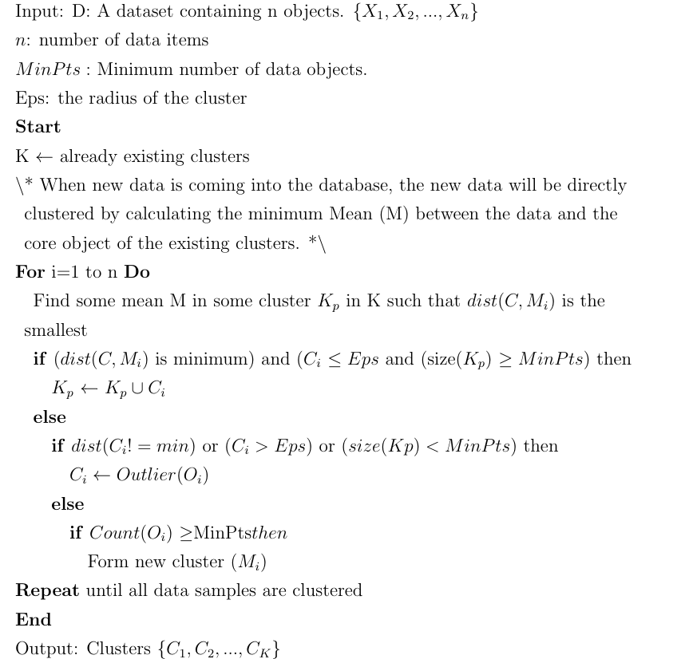
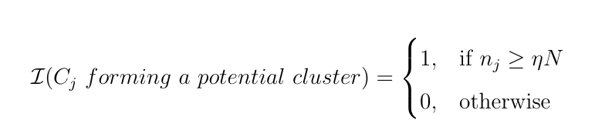
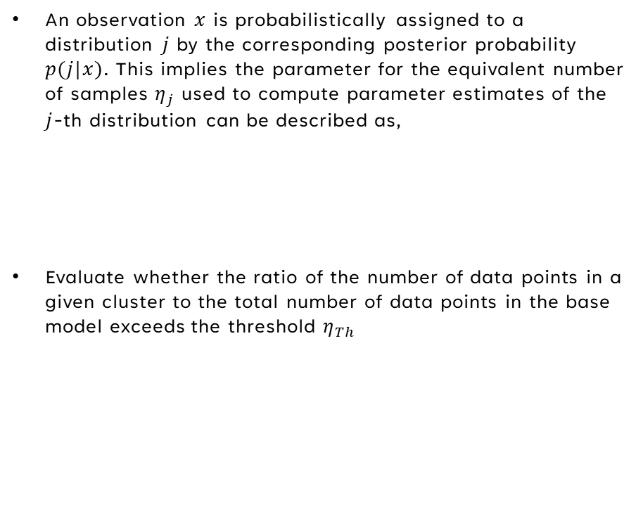
Incremental dbscan AS AN AUXILLIARY MODEL
An observation $x$ is probabilistically assigned to a distribution $j$ by the corresponding posterior probability $p(j|x)$. This implies the parameter for the equivalent number of samples $η_{j}$ used to compute parameter estimates of the $j$-th distribution can be described as,
Evaluate whether the ratio of the number of data points in a given cluster to the total number of data points in the base model exceeds the threshold $η_{Th}$

Slide 18
Experiments and results

Slide 19
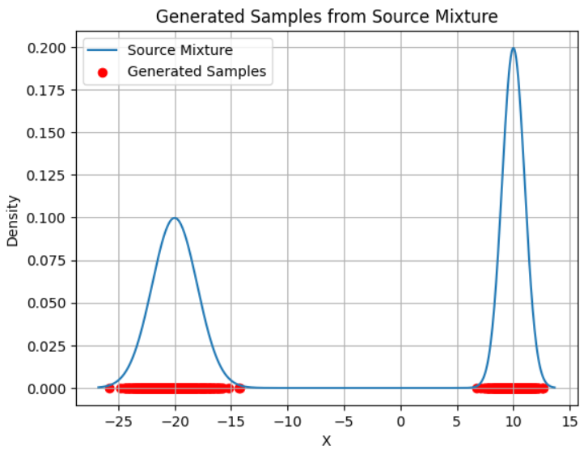
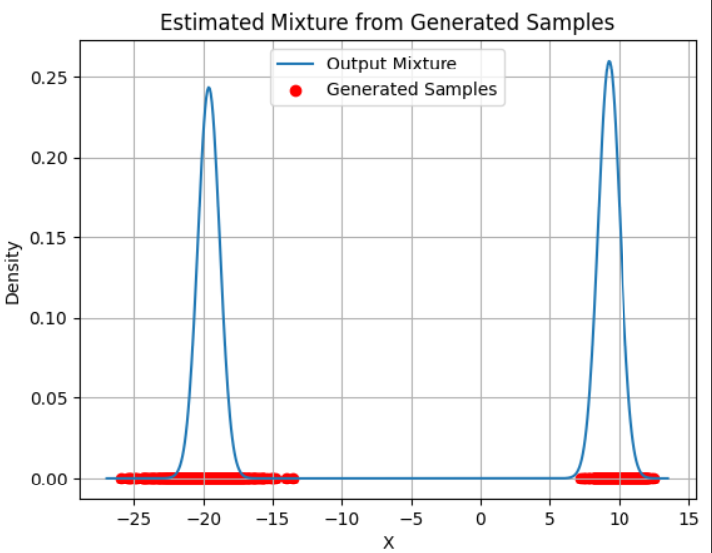
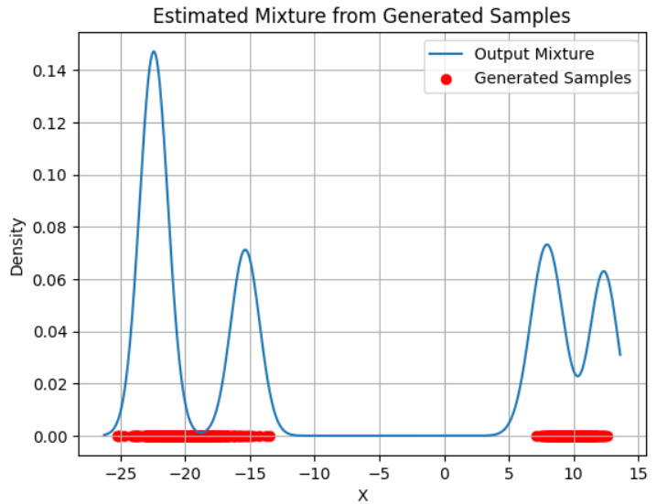
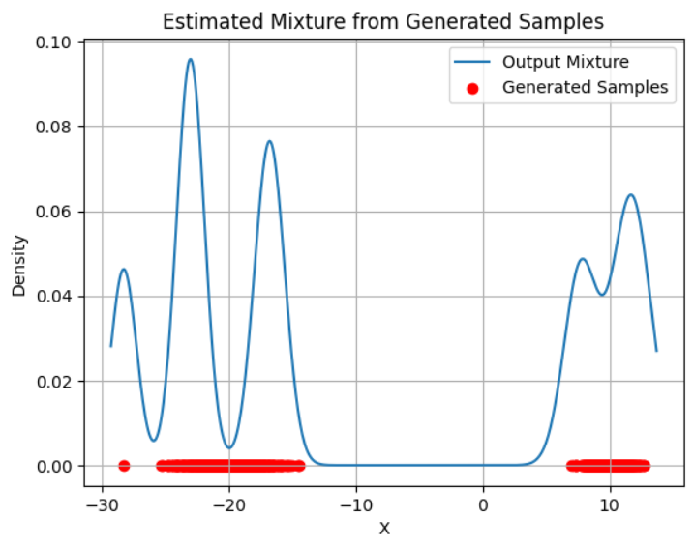
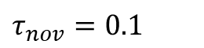
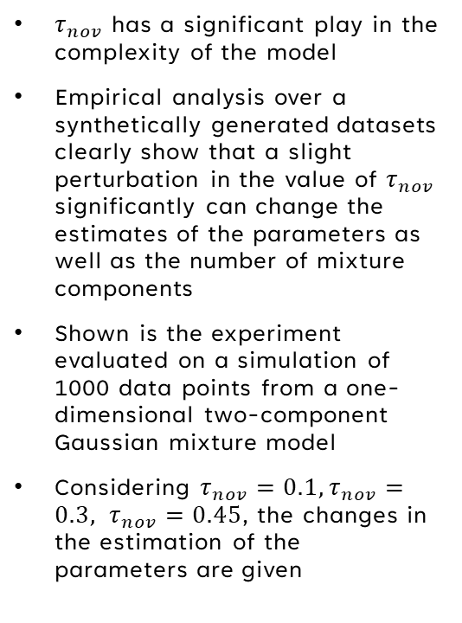
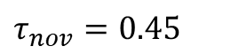
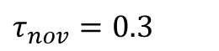
Limitation of IGMM
Sensitivity analysis of $τ_{nov}$
$τ_{nov}$ has a significant play in the complexity of the model
Empirical analysis over a synthetically generated datasets clearly show that a slight perturbation in the value of $τ_{nov}$ significantly can change the estimates of the parameters as well as the number of mixture components
Shown is the experiment evaluated on a simulation of 1000 data points from a one-dimensional two-component Gaussian mixture model
Considering $τ_{nov}=0.1,τ_{nov}=0.3, τ_{nov}=0.45$, the changes in the estimation of the parameters are given
$τ_{nov}=0.1$
$τ_{nov}=0.3$
$τ_{nov}=0.45$

Slide 20
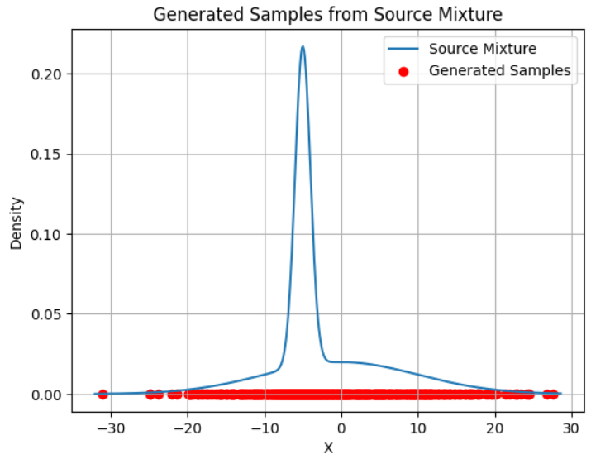
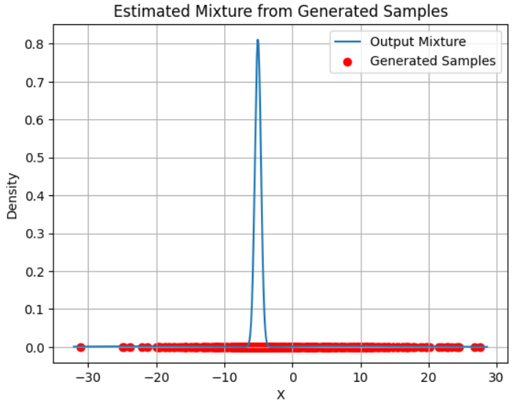
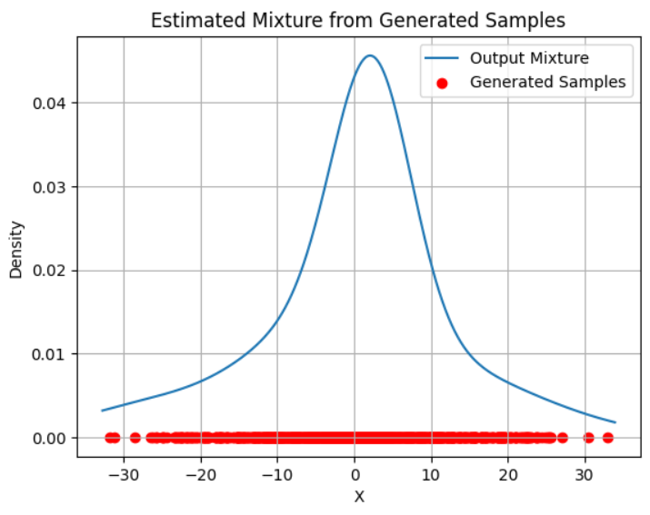
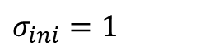
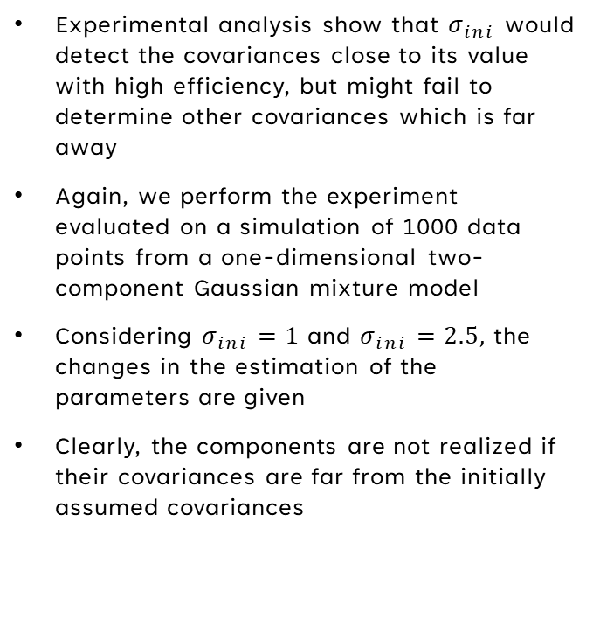
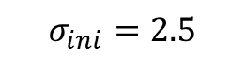
Limitation of IGMM
Non-uniformity of source mixture
Experimental analysis show that $σ_{ini}$ would detect the covariances close to its value with high efficiency, but might fail to determine other covariances which is far away
Again, we perform the experiment evaluated on a simulation of 1000 data points from a one-dimensional two-component Gaussian mixture model
Considering $σ_{ini}=1$ and $σ_{ini}=2.5,$ the changes in the estimation of the parameters are given
Clearly, the components are not realized if their covariances are far from the initially assumed covariances
$σ_{ini}=1$
$$σ_{ini}=2.5$$

Slide 21
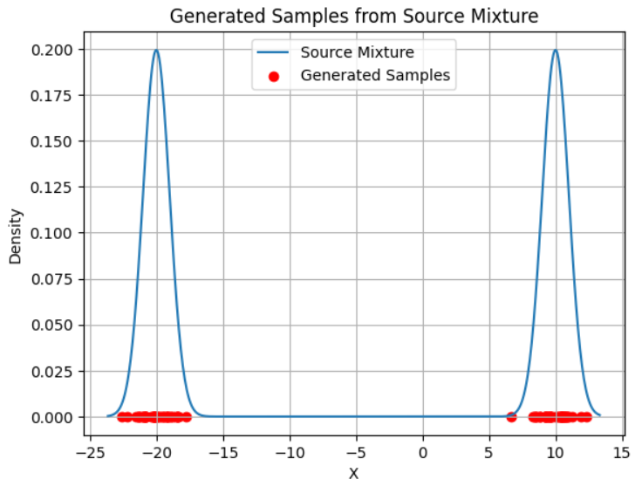
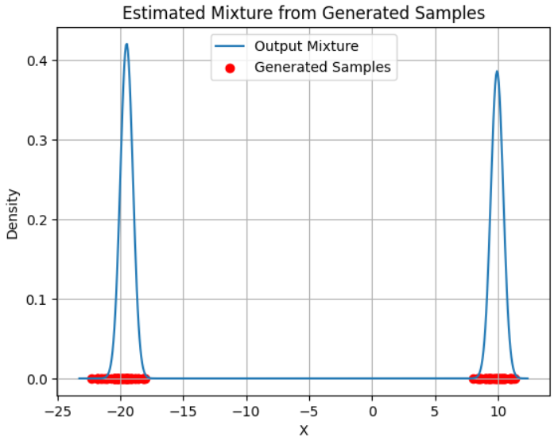
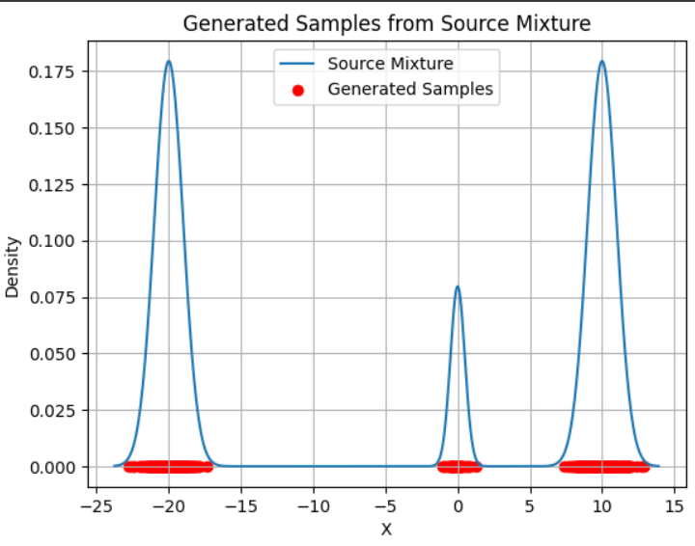
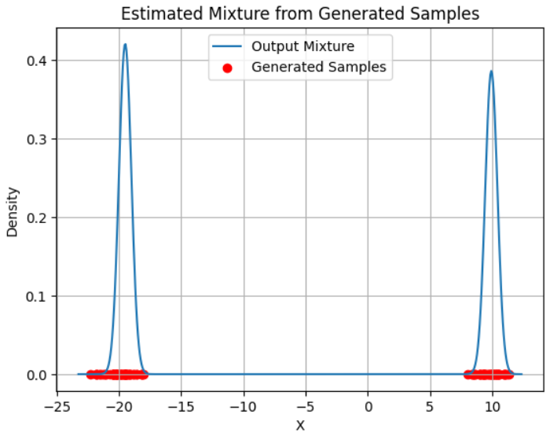
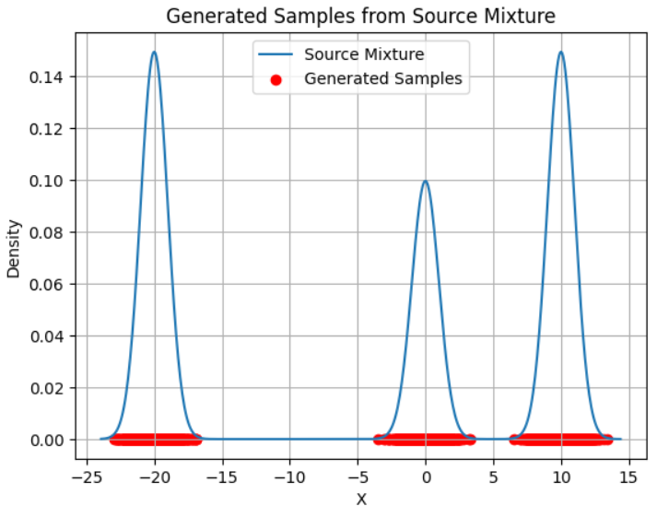
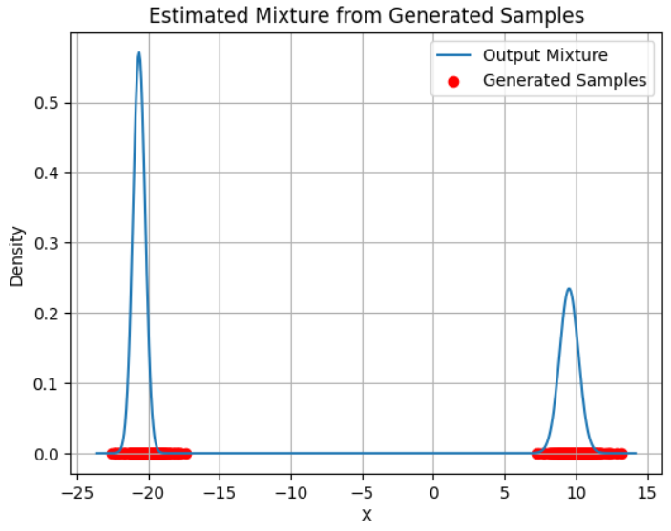
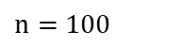
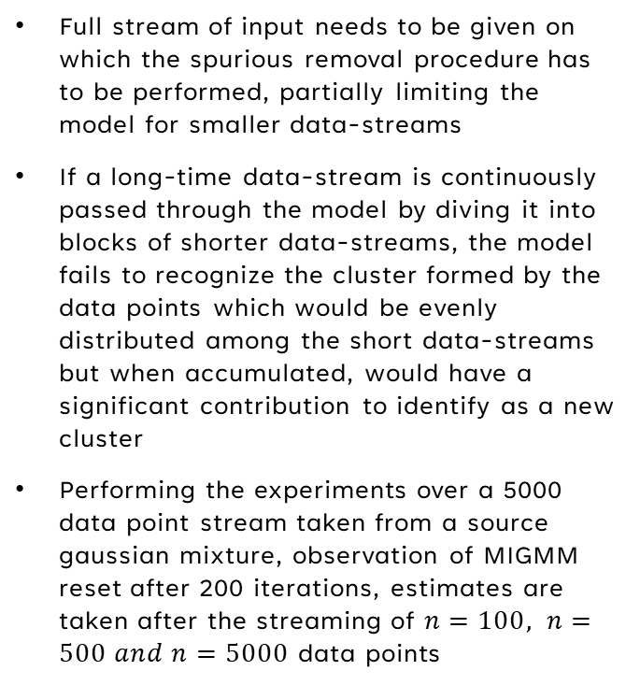
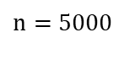

Limitation of MIGMM
Inability to detect the outliers
Full stream of input needs to be given on which the spurious removal procedure has to be performed, partially limiting the model for smaller data-streams
If a long-time data-stream is continuously passed through the model by diving it into blocks of shorter data-streams, the model fails to recognize the cluster formed by the data points which would be evenly distributed among the short data-streams but when accumulated, would have a significant contribution to identify as a new cluster
Performing the experiments over a 5000 data point stream taken from a source gaussian mixture, observation of MIGMM reset after 200 iterations, estimates are taken after the streaming of $n=100, n=500 and n=5000$ data points
$n=100$
$n=500$
$n=5000$

Slide 22

Evaluation of 2f-igmm with migmm
CASE-I: Estimation from a fully streamed dataset
Empirical assessment of the accuracy of the 2F-IGMM and MIGMM is done to judge how close the estimate is to the source-mixture components
No exhaustive search is performed to train and optimize the hyperparameters of 2F-IGMM as well as MIGMM
First experiment is done on 10000 datapoints simulated from a two-dimensional three-component Gaussian mixture model. The following table shows the estimates realized by both the models
It can be noticed that both the algorithms are quite close in computing the means, but show a significant difference and hence, fail to estimate accurate priors and covariances

Slide 23




Evaluation of 2f-igmm with migmm
CASE-II: Estimation from a streaming dataset succumb to outliers
The second experiment computes the data stream from a one-dimensional three-component GMM, forming one cluster at a later stage
Shown are the results of estimates computed by MIGMM and 2F-IGMM model
2F-IGMM computes the stream parallelly, and realizes the concepts and outliers in a better way, but fails to develop efficient parameter estimates
Experiment show that MIGMM does not realize the outliers forming a cluster since it needs to reset after some iterations, partially destroying the property of adaption
$MIGMM$
$2f−IGMM$

Slide 24


Sensitivity analysis of 2F-IGMM
Sensitivity analysis of $η_{Th}$
$η_{Th}$has a significant play in the efficiency of the model
Empirical analysis over a synthetically generated dataset clearly show that a slight perturbation in the value of $η_{Th}$significantly can change the estimates of the parameters as well as the number of mixture components
Shown is the plot of Davies-Bouldin index score over a range of values of $η_{Th}$ ranging from 0.15 to 0.85

Slide 25

Evaluation of 2f-igmm ON a real-world data
Gathered a financial dataset of 5 stocks containing past 10 years of dataset
Extracted financial features including:
Simple Moving Average
Exponential Moving Average
Relative Strength Index
Moving average Convergence Divergence Line
MACD Signal Line
It can be noticed that the algorithm developed is efficient to compute the means and a relative covariance value, but significantly overdetermines the number of clusters

Slide 26


Evaluation of 2f-igmm ON a real-world data
Using PCA, we compute the first 2 significant eigenvalues to capture the scatter plot visualization over the dataset
Clusters observed by EM Algorithm
Clusters observed by 2F-IGMM Model

Slide 27
Conclusion and Future work

Slide 28

Conclusion
Developed an efficient estimate to determine the set of outliers
Proposed a two-fold partition framework to handle the detection and merging of outliers from the data set
Designed a completely adaptive model which can handle long, continuous and an irregular data-stream
Future work
Extensive quantitative analysis of 2F-IGMM model and other unsupervised models need to be performed to exactly evaluate the accuracy metric of the models, to incorporate inadequacies of the models
A more accurate approach to shift the outliers to the data set need to be explored
An efficient criterion of selecting $τ_{nov}$, $σ_{ini}$ and $η_{Th}$ through sensitivity analysis and hyperparameter optimization needs to be explored
Extensive analysis of comparison between $σ_{ini}$ and the convergence rate of the update equations can be done
Reducing the computational complexity of the model also warrant future research
Clear and efficient metric to adapt the hyperparameters through an efficient grid search method or an efficient forward pass through models such as neural networks have a potential to increase the efficiency of the model

Slide 29
References

Slide 30
Bergstra, J., Bardenet, R., Bengio, Y., and K´egl, B. (2011). Algorithms for hyperparameter optimization. Advances in neural information processing systems, 24(2):12–21
Engel, P. M. and Heinen, M. R. (2010). Incremental learning of multivariate gaussian mixture models. Advances in Artificial Intelligence–SBIA 2010: 20th Brazilian Symposium on Artificial Intelligence, S˜ao Bernardo do Campo, Brazil, 2(2):82– 91
Moon, T. K. (1996). The expectation-maximization algorithm. IEEE Signal processing magazine, 13(6):47–60
Pinto, R. C. and Engel, P. M. (2015). A fast incremental gaussian mixture model. PloS one, 10(10):30–42
Reynolds, D. A. et al. (2009). Gaussian mixture models. Encyclopedia of biometrics, 7(4):659–663
Sun, S., Tong, Y., Zhang, B., Yang, B., Yan, L., He, P., and Xu, H. (2023). A novel adaptive methodology for removing spurious components in a modified incremental gaussian mixture model. International Journal of Machine Learning and Cybernetics, 14(2):551–566

Slide 31
THANK YOU

